Slide 1
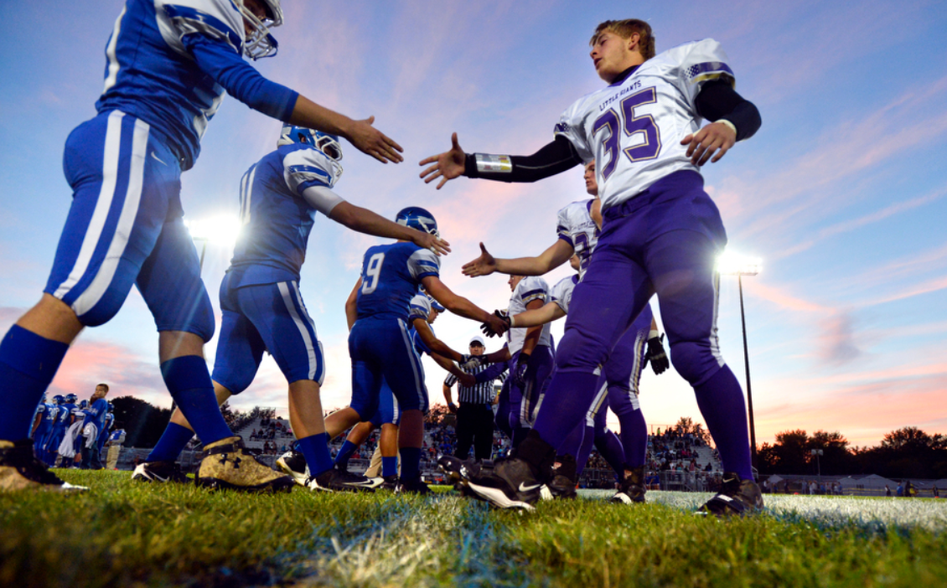
Leading Teams in Professional Sports
By Kerima, Nina and Nin

Slide 2
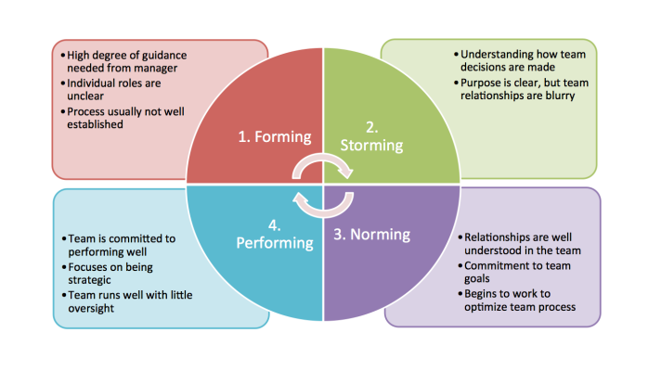

Slide 3
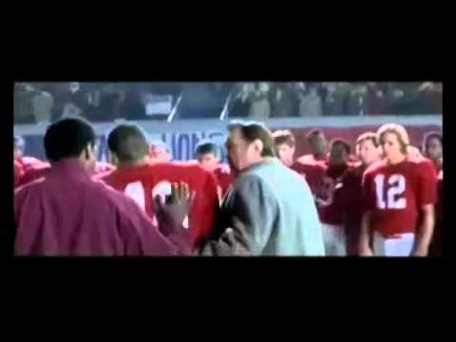
Today’s athletes and teams are taking a more active role. Some of the country’s most high-profile athletes have spoken out in favor of Black Lives Matter
Notes:
This is a visual representation of the 4 stages I mentioned in the previous slide, and then some because there are other factors in developing sports teams.

Slide 4
Behavioral Approach
Actively driven for the same goal.
Effect teams have high engagement
Contributing is to define the goals and
determining how the team will get there
Notes:
Best cohesive teams will need a group goals to be matching with the with the organization's goals. This creates more of a cohesive team.
When the organization and the owners only focus only players winning games and making profits, they ignore the human behavioral issues of players.
The team captains are the Democratic Leaders that encourage higher moral and job satisfaction.
The team owners are Autocratic Leaders that make decisions on who the players will be, so that they can have a strategy on winning games. They could not be more understanding in situational factors.

Slide 5
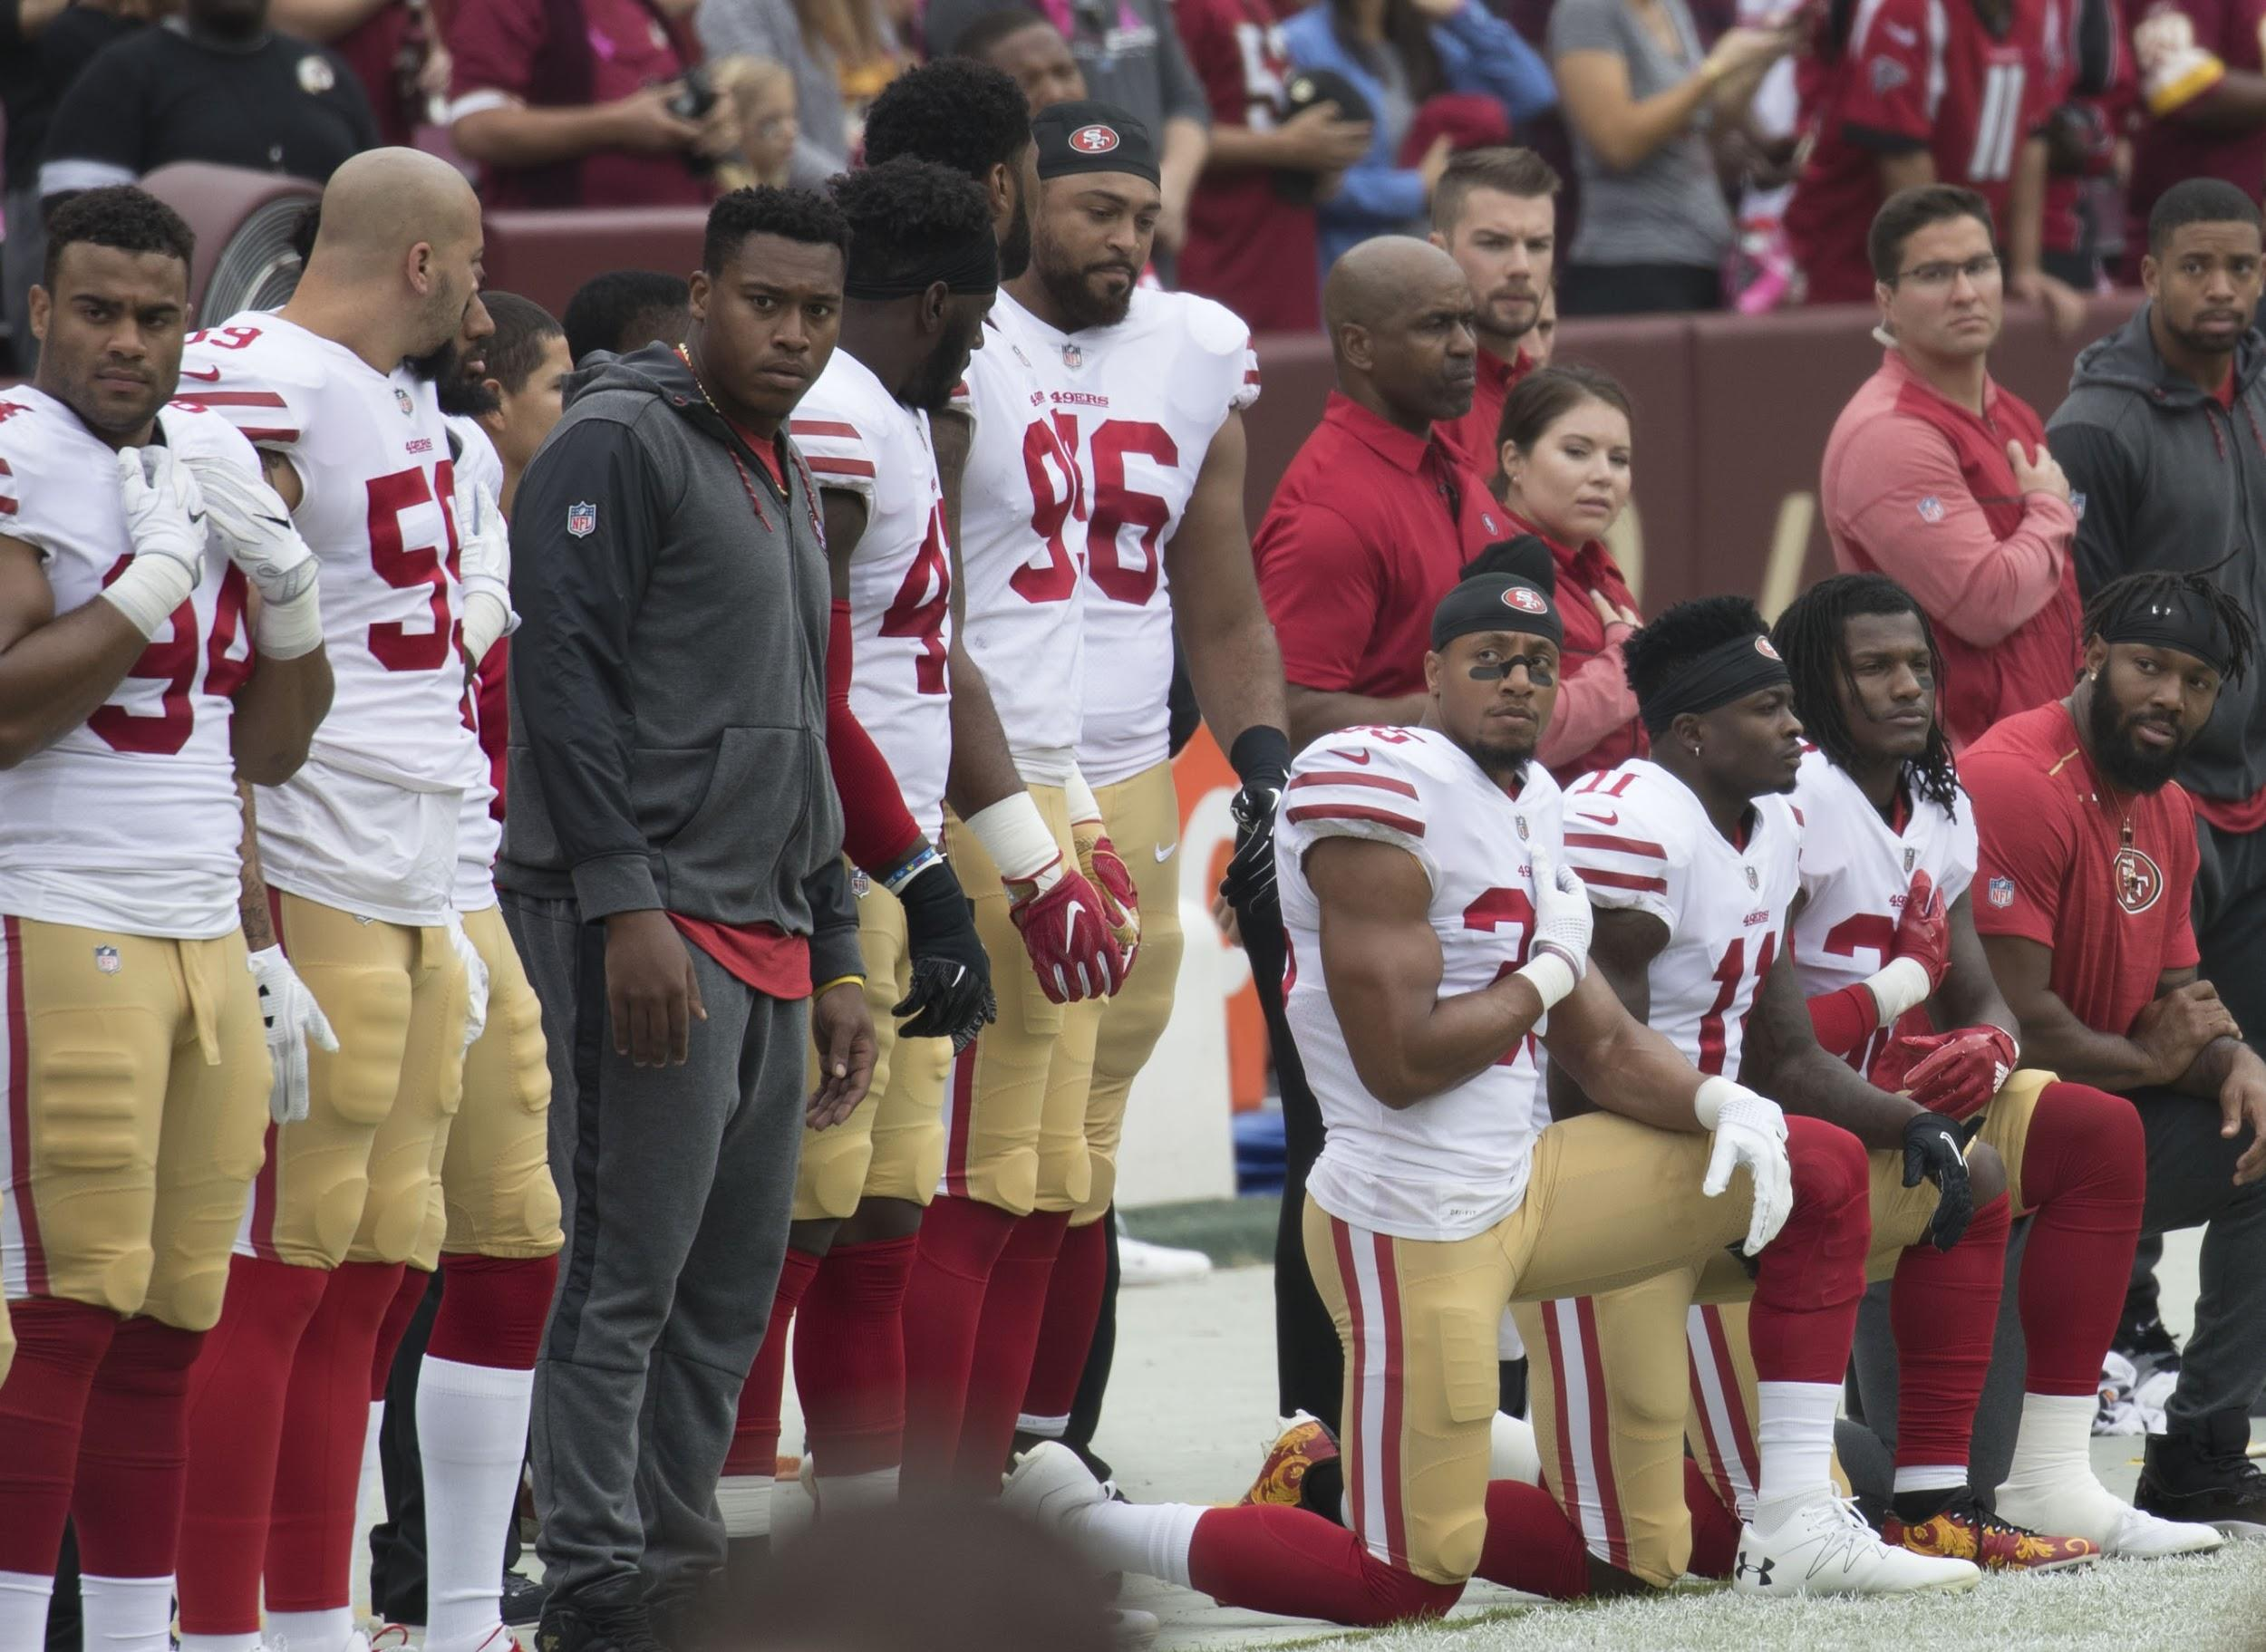
Notes:
Many NFL players started to kneel or sit during the National Anthem in response to the racial inequality and police brutality of AfMany NFL players started to kneel or sit during the National Anthem in response to the racial inequality and police brutality of African Americans in the United States. This movement began with Colin Kaepernick initiating the action during the San Francisco 49’ers game against the Chargers on September 1, 2016. rican Americans in the United States. This movement began with Colin Kaepernick initiating the action during the San Francisco 49’ers game against the Chargers on September 1, 2016.

Slide 6
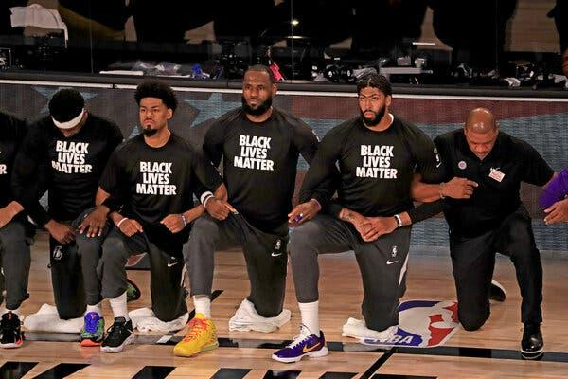
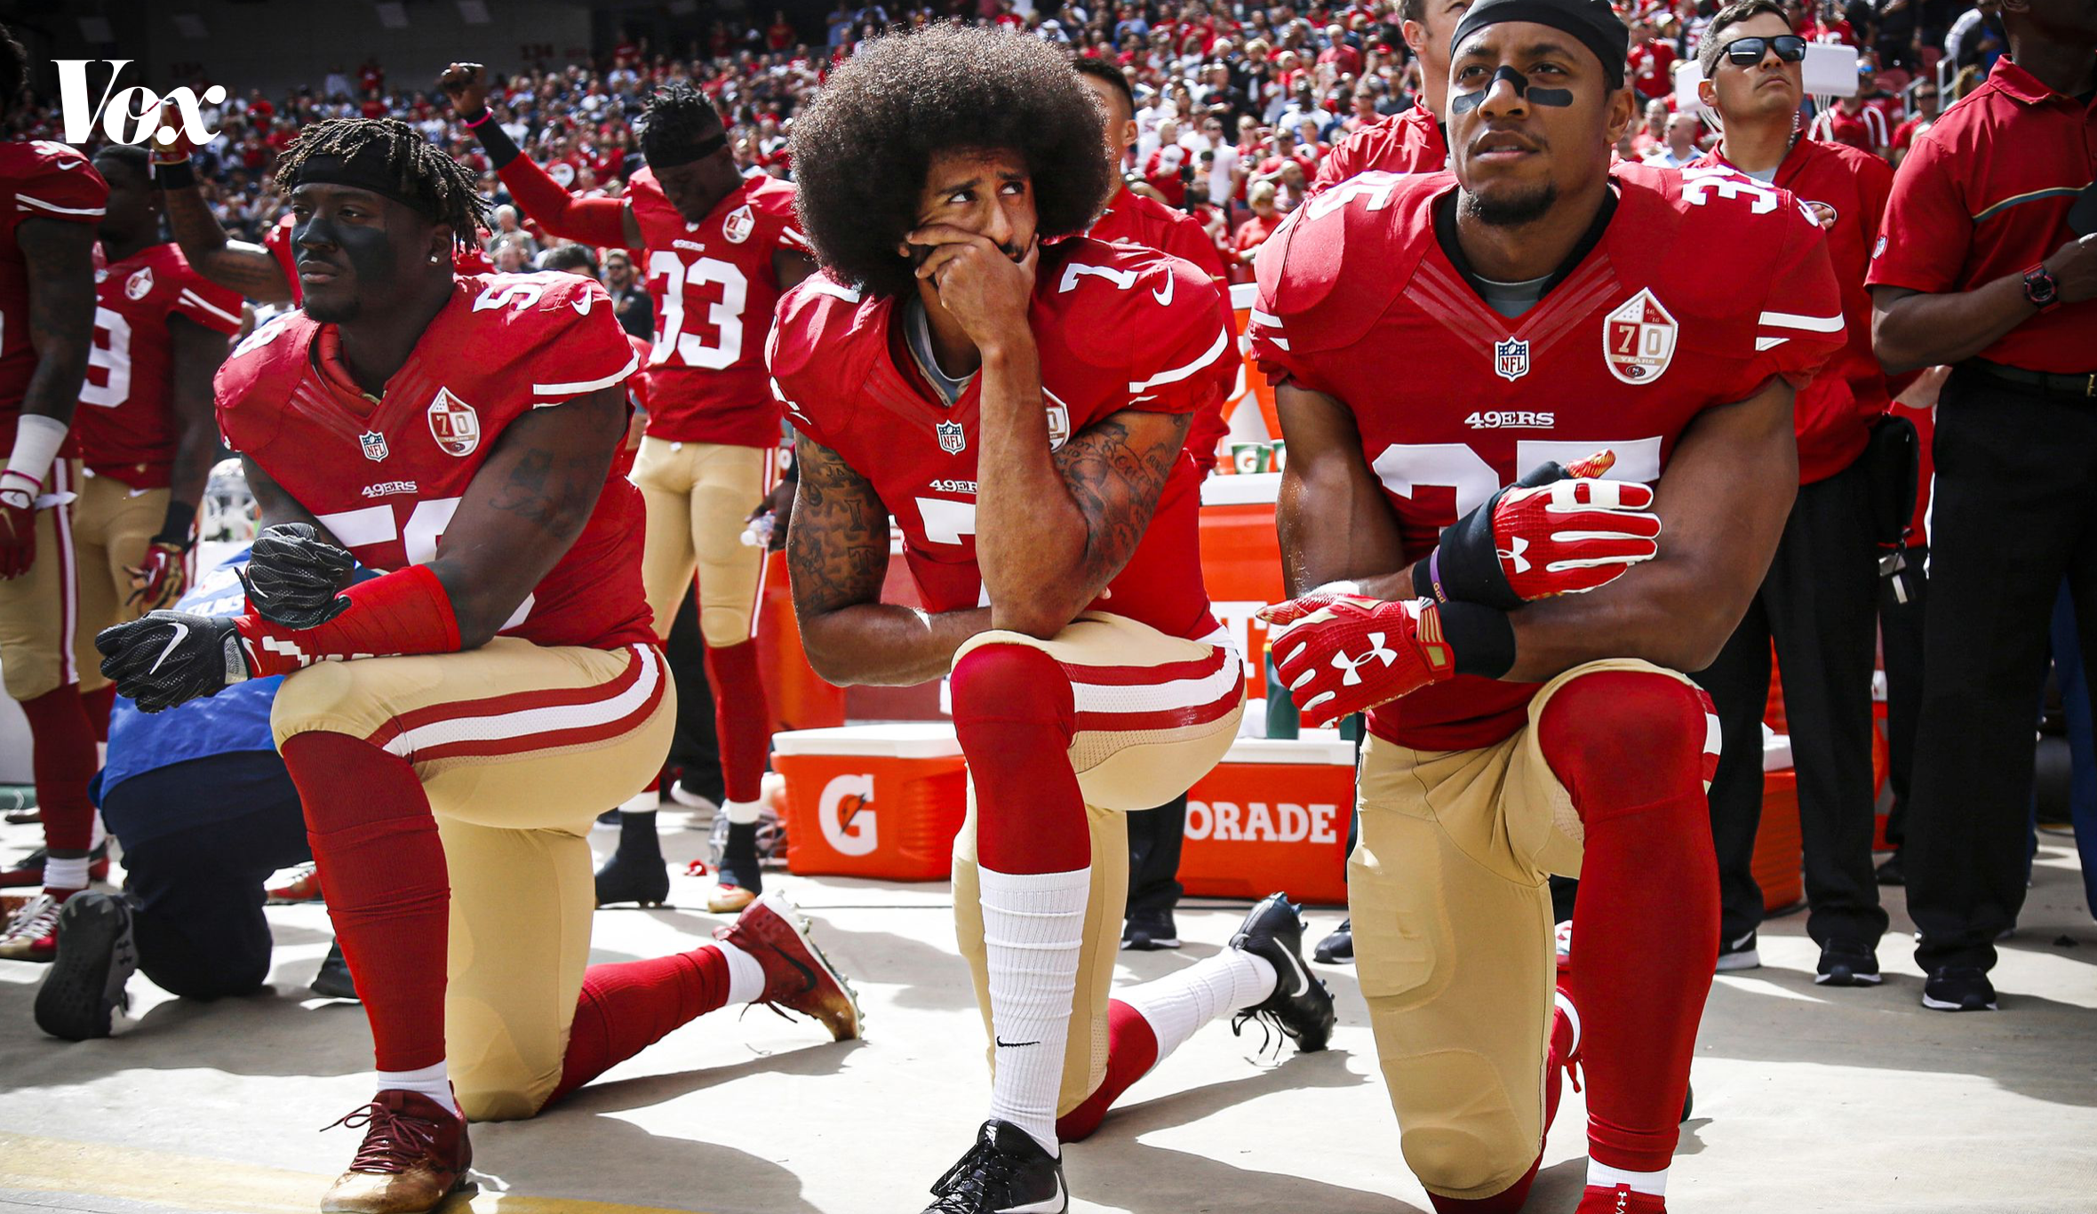
Photo credit by Mike Erhmann for NY Times
Photo credit Nhat V. Meyer via Getty Images
Notes:
Kaepernich said that he consulted with veterans on the most respectful way he could demonstrate in peaceful protest. The military veteran suggested that by kneeling, this would be the most respectable way to protest.
This action spark a lot of contorversy and division in the organization. Many of the organizations players on other teams followed as well as other sports organizations in taking a knee during the National Anthem.

Slide 7
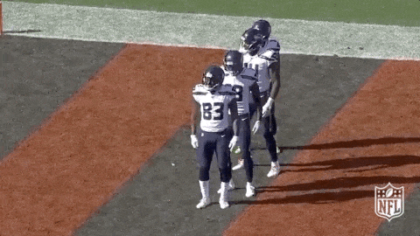
Emotional Intelligence in sports teams
What is the connection between team success and emotional intelligence?
Giphy image NFL: Seattle Seahawks celebrating touchdown
Notes:
“Good emotional intelligence gives teams the foundation to work together productively by creating a shared sense of empathy, ensuring that team members understand each other and their problems. It allows the team to prioritize communication and collaboration.”(www.profilesasiapacific.com)

Slide 8
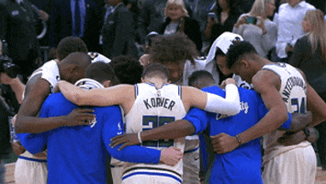
How is emotional intelligence used and what ways can it be used?
Here are 5 ways:
Conflict Resolution
Collaboration
Self-Awareness and Emotional Management
Understanding Team Capabilities
Creating Team Motivation
Giphy image: NBA
Notes:
Conflict Resolution: In Conflict Resolution, EI enhances communication skills to discuss issues, and have empathy and look at others point of view. This also helps working on frustrations by allowing members to vent their problems.
Collaboration: Collaboration in teams helps with achieving timelines, preserving emotional and physical energy as well as forming time management.
Self-Awareness & Emotional Management: Teammates who are aware of their own emotions and reactions are more likely to regulate their outward emotions. Which helps with managing one’s own stress and to have empathy for others stress levels.
Understanding Team Capabilities: One way teammates can understand each other’s capabilities is to take on the others responsibilities and train in their role. This aids in understanding their teammates struggles, as well as accomplishments.
Creating Team Motivation: Motivation enhances team performance. Ways to create motivation is to engage in team building exercises, as well as recognition ceremonies which gives each other a sense of purpose in the environment.

Slide 9
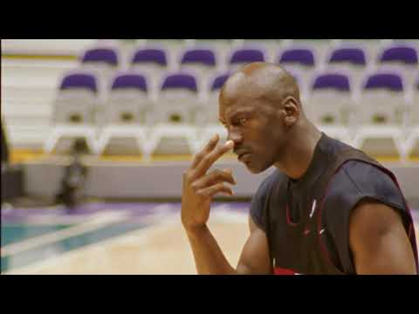
Notes:
Motivation isn’t always about praising and patting your teammate(s) on the back. Getting on an under performer to do better can result in a more positive outcome. This is known as the Tough Guy attitude. Sometimes fear and intimidation can motivate teammates to want to work harder.
Michael Jordan, who was known as one of the greatest athletes and is a basketball legend from the 1990’s, who also had millions of fans around the world, was the most feared teammate on the Chicago Bulls basketball team. Here is a clip from the 2020 documentary series, “The Last Dance” to illustrate just that.
(play video clip)
This form of EI makes teammates accountable for their own performance, but if it’s to harsh it can have the adverse effect on the members performance. This is where coaching is important.

Slide 10
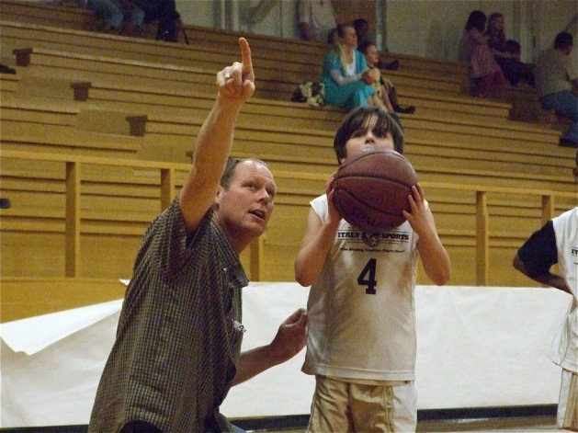
Coaching & Leadership
“In particular, empathy and emotional contagion are considered particularly important in coaches” (Laborde, 2016)
Leadership is just as effective as having good relationships
Coaches have to have effective leadership skills and be able to adapt to the emotional needs of their players
Photo credit Getty Images
Notes:
Sports coaches are important in assisting athletes develop their potential. They motivate minds as well as muscles. But it’s a two way street. Athletes must accept the coaching in order to succeed.
Coaches are able to understand non-verbal cues, unspoken words and the individuals contributions in the team dynamic.
Coaches must nurture each players confidence personally and professionally.
The benefits can be vast. Coaches promote inclusion, communication, skill building and confidence.

Slide 11
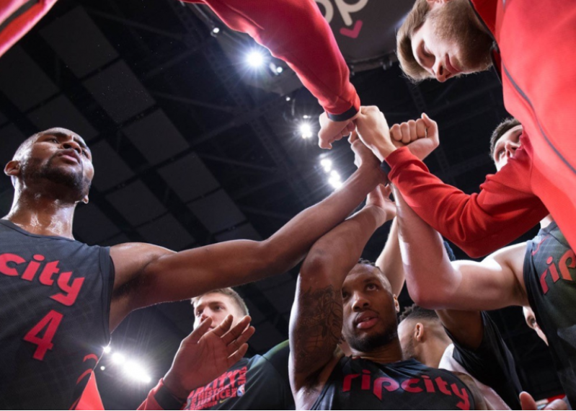
The Strength of Diversity

Slide 12
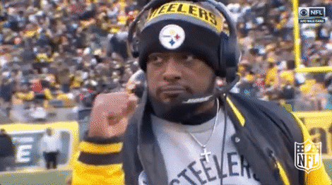
The Strength of Diversity
Foster Creativity and innovation
Promotes better decisions making
Creates inclusion culture
Notes:
Why does Diversity matter?
Increse diveristy

Slide 13


Slide 14
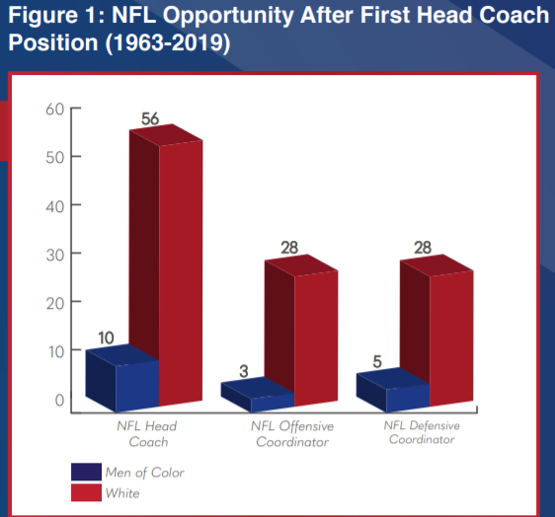
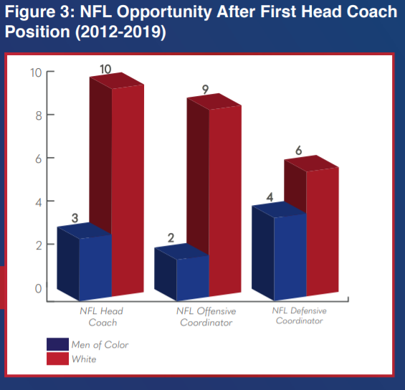
Notes:
Since the start of the 1963 NFL season, 112 White individuals have been hired as an NFL head coach, offensive coordinator or defensive coordinator after a first NFL head coach opportunity, whereas only 18 men of color have been hired as an NFL head coach, offensive coordinator or defensive coordinator after a first head coach opportunity. In addition, since the start of the 1963 NFL season, 24 White individuals have been hired as an NFL head coach, offensive coordinator or defensive coordinator after a second NFL head coach opportunity, whereas only three men of color have been hired as an NFL head coach, offensive coordinator or defensive coordinator after a second head coach opportunity. “

Slide 15
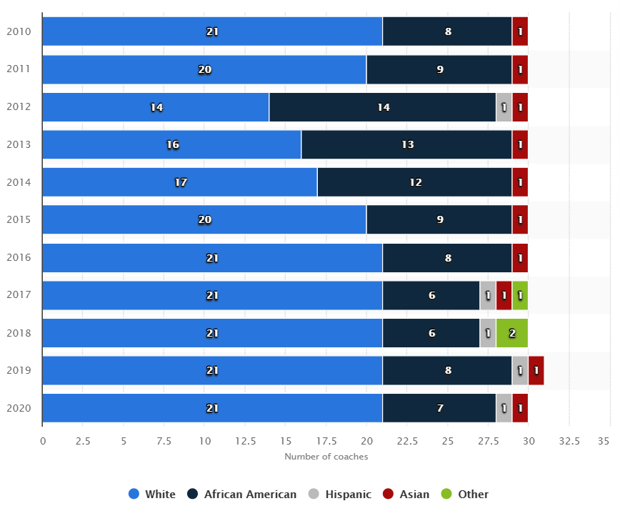
Coaches in NBA

Slide 16
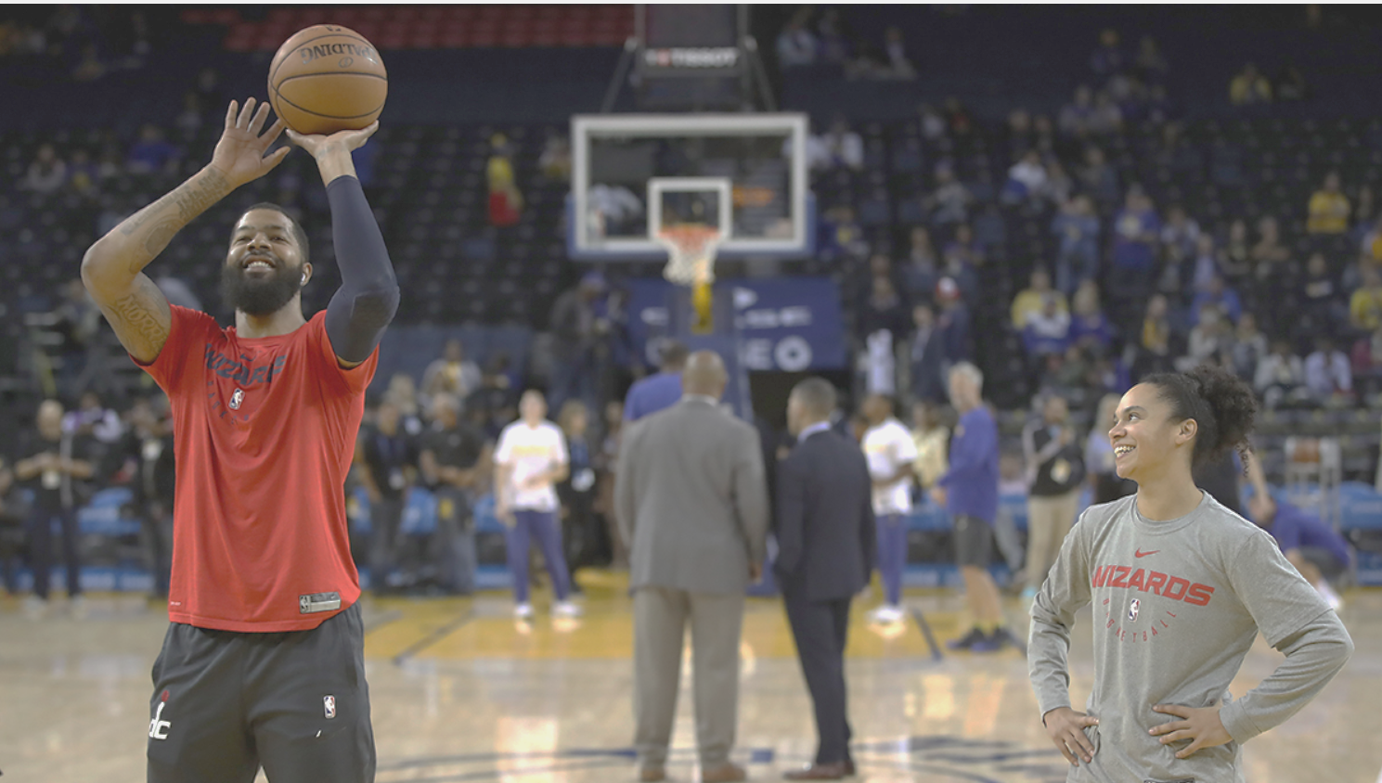
Is there a correlation between diversity and success?
Notes:
Assistant coach Kristi Toliver of the Washington Wizards stands on the court with Markieff Morris #5 during warm-ups before their game against the Golden State Warriors at ORACLE Arena on October 24, 2018 in Oakland, California. NOTE TO USER: User expressly acknowledges and agrees that, by downloading and or using this photograph, User is consenting to the terms and conditions of the Getty Images License Agreement. (Photo by Ezra Shaw/Getty Images)
Diverse sport teams can discover new heights of success, better teamwork and prevent groupthink.
“As the industry has evolved over the years, you see more people of color have access to participate in those positions and have benefited from those who have entered into the space before them.” - Arthur McAfee, the NFL’s senior vice president of player engagement.

Slide 17

Diversity = Success?
If theory is that diversity creates success than the top five teams in the NFL and the NBA should be the most diverse…
Giphy Images: crowd cheering
Notes:
Super Bowl LIII – New England Patriots.
Super Bowl LII – Philadelphia Eagles.
Super Bowl LI – New England Patriots.
Super Bowl 50 – Denver Broncos.
Super Bowl XLIX – New England Patriots.

Slide 18
References
Photo credit:
Mike Erhmann
https://www.nytimes.com/2020/08/28/opinion/NBA-boycott-history.html
Nhat V.Meyer
https://www.vox.com/the-highlight/2019/10/21/20921462/nfl-football-woke-colin-kaepernick-take-a-knee
Video Links:
https://www.youtube.com/watch?v=_akGhaZ7ZGI
https://www.youtube.com/watch?v=hEJaz3sinEs
Websites:
https://www.profilesasiapacific.com/2018/07/19/emotional-intelligence-and-teamwork/
https://coachfederation.org/blog/work-with-emotional-intelligence
Nina’s Slides
https://operations.nfl.com/media/3789/2019-nfl-diversity-inclusion-report.pdf
https://43530132-36e9-4f52-811a-182c7a91933b.filesusr.com/ugd/7d86e5_5af5faf45ba7443da733f900f54638b4.pdf
https://link.springer.com/article/10.1007/BF03396785
https://43530132-36e9-4f52-811a-182c7a91933b.filesusr.com/ugd/7d86e5_5af5faf45ba7443da733f900f54638b4.pdf
Scholarly Article:
Laborde, S., Dosseville, F., Allen, M.S., (2016) “Emotional Intelligence in sport and exercise: A systemic review”, Scandanavian Journal of Medicine & Science in Sports, (page 5)

Slide 19
References continued
http://blogs.pjstar.com/eye/2012/09/15/limestone-rockets-soar-over-canton-49-15/
https://hbr.org/2016/11/why-diverse-teams-are-smarter
GIF images by Giphy at www.giphy.com
Seattle Seahaws touchdown celebration: https://giphy.com/gifs/nfl-seattle-seahawks-ggFGAtIaickGGdmwX4
NBA basketball gif:
https://giphy.com/gifs/nba-lMClpjMduVeeM5RUlb

