Slide 1

The Tech Divide
ORGL 4040
Human Resource Leadership
SHR BP Presentation
Nin, Nina, and Kerima
Notes:
I JUST WANT TO PREFACE THIS AND SAY, THIS IS NOT A PRESENTATION ABOUT KIM KARDASHIAN. SHE IS JUST PART OF THE INTRODUCTION.
If you’ve been living under a rock, you probably didn’t know that Kim Kardashian, who is a savvy business woman, has a huge part in todays tech industry. A reality star, a social media maven, a brand, Kim Kardashian is one of few women who used the tech industry to earn profits by engaging audiences far and wide.
However she is one woman in the tech field who has been extremely successful in creating an empire in technology. No other woman has been able to achieve her level of popularity in the tech industry, though many are following in her footsteps.
But she is not the first woman to engage in technology, and this presentation, will hopefully educate you on why there are not a lot of women in that industry, and how can we change that.

Slide 2
Key components we will be addressing
Who are the women in tech
Compare salaries
Why there were disadvantages for women in tech
Best practices for strategic reward
Best practices for performance management
Best practices for employment relationship in the US
3 Best practices examples for hiring
Concluding with a final thought

Slide 3

Notes:
This short video from the Economist gives and explanation about how women earn less than men.

Slide 4
Women v Men
Salaries
“In 2015, the United Nations established the International Day of Women and Girls in Science (February 11, 2015) to raise awareness about the importance of diversifying STEM (science, technology, engineering and mathematics), and to break down the barriers preventing access to these fields for women and girls” (www.un.org)
On average a woman working full time earns 80.7 cents for every dollar a man working full time earns.
The median annual income amount a woman makes is $9,909.00 less than their male counterparts.
In tech women are offered 3% less than a man in the same job in many companies according to 2019 data from hired.com

Slide 5



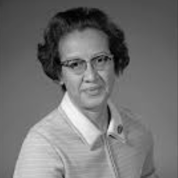
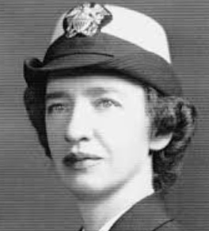
Female Pioneers in Tech
Ada Lovelace
World’s 1st Computer Programer
1815-1852
Hedy Lamarr
Radio frequency inventor
1914-2000
Katherine Johnson
Black mathematician for NASA
1918-2020
Grace Hopper
Pioneer in software language
1906-1992
Notes:
Just who are these women in tech and how did it all start?
Ada Lovelace, born from English nobility. She was a mathematician, a writer and the first computer programmer. She wrote the computing machine algorithm that existed only on paper.
Hedy Lamarr was born in Austria and was a Hollywood film actress, and was credited with helping invent the technology that would eventually be used in Bluetooth and internet.
Katherine Johnson, was an American mathematician for NASA in the 1960’s. As one of the very few black women in the field, she helped calculate orbital mechanics for the US’s first space launches.
Grace Hopper, another American, was one of the first inventors of computer software language. She also served in the US Navy.

Slide 6






Comparing salaries
Average Man’s Salary: $129,000.00
Average Woman’s Salary: $112,000.00 ($17,000.00)
Average Man’s Salary: $121,000.00
Average Woman’s Salary: $109,000.00 ($12,000.00)
Average Man’s Salary: $119,500.00
Average Woman’s Salary: $114,500.00 ($5,000.00)
Average Man’s Salary: $118,500.00
Average Woman’s Salary: $106,500.00 ($12,000.00)
Average Man’s Salary: $120,000.00
Average Woman’s Salary: $109,000.00 ($11,500.00)
Average Man’s Salary: $119,000.00
Average Woman’s Salary: $113,500.00 ($5,500.00)
Business Insider

Slide 7
Why are men making more than women?
May be because of the fact that software engineers at tech companies hire mostly men.

Slide 8
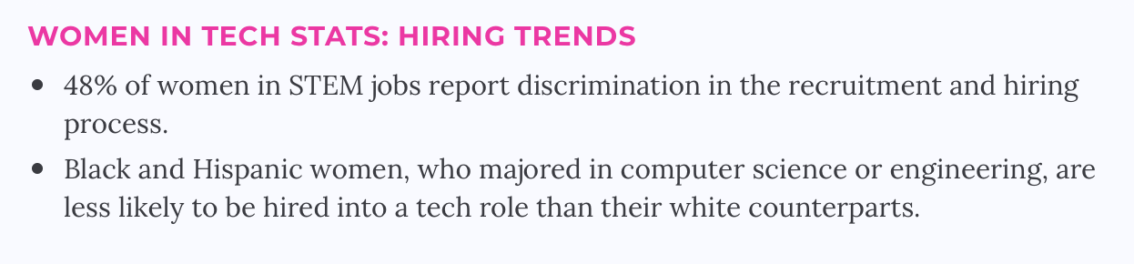
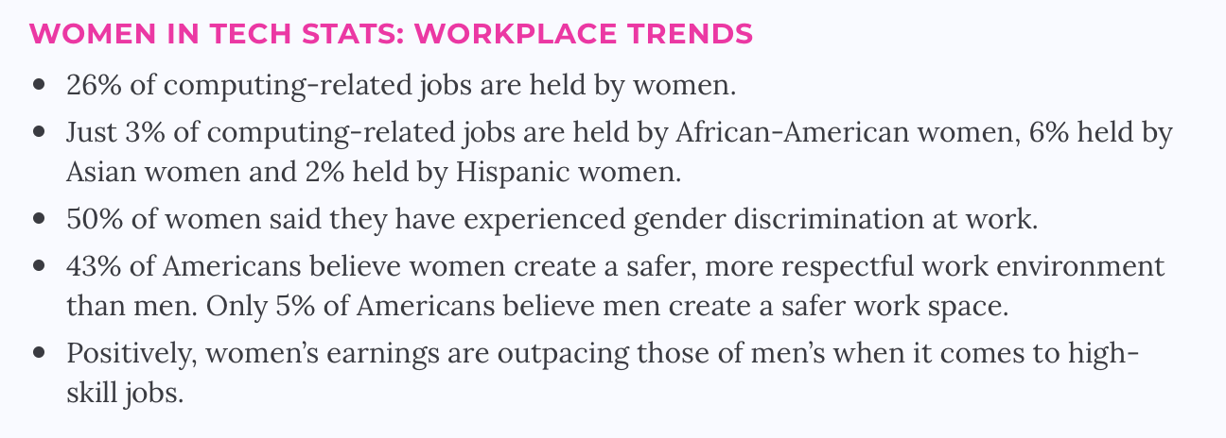
Notes:
Here are some stats

Slide 9
Best practice for strategic reward
Notes:
​“Per­for­mance man­age­ment is the con­tin­u­ous process of improv­ing per­for­mance by set­ting indi­vid­ual and team goals which are aligned to the strate­gic goals of the organ­i­sa­tion, plan­ning per­for­mance to achieve the goals, review­ing and assess­ing progress, and devel­op­ing the knowl­edge, skills and abil­i­ties of peo­ple.”

Slide 10
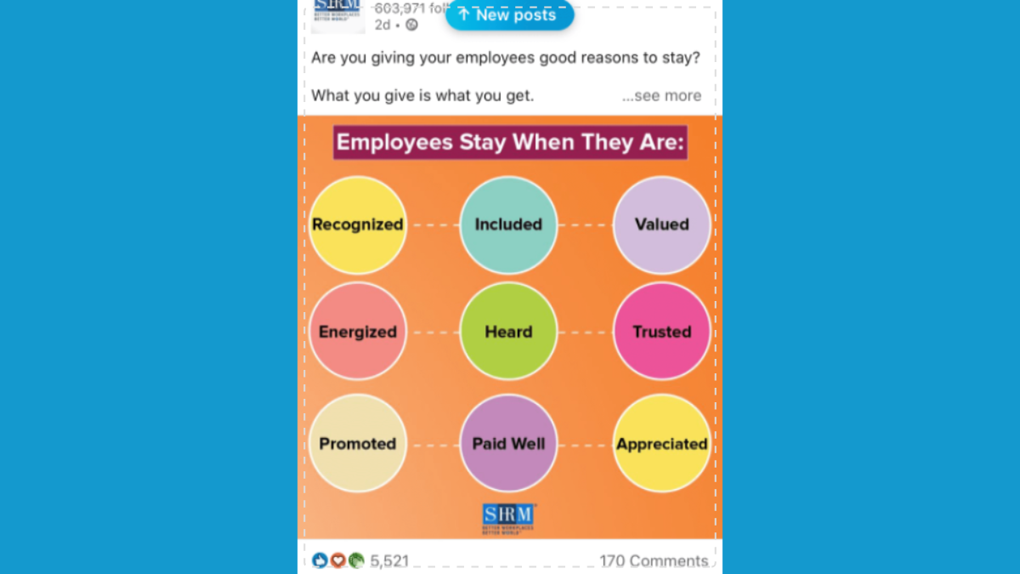

Slide 11

Compensation
Health Benefits
Work-life balance
Performance & Recognition
Development & Career Opportunities

Slide 12
Company
IBM
Accenture
Salesforce
Appnexus
Ericcson
Benefit
Equal Pay
Extensive Training
Female Lead Board
Gender Balanced Workplace
Work Life Balance
Flexible Schedule

Slide 13
Best practice for strategic employment
Core Competency Testing
Core competency testing helps paint a better picture for employers about the potential of individual staff members
Employee development and engagement in the job is really important to hire properly
Hiring employees that have the right skills, experience, and knowledge and fit for the job

Slide 14
Best practices for employment relations in the US
Promote Dialogue and Communication
Open dialogue and clear communication is key to good employee relations
Good communication helps to avoid employee confusion and unnecessary stress.
Focus on Company Missions and Values
Sharing with employees the company values and mission.
Most people want to be part of something bigger than themselves.
Help Employees Feel Valued
Say thank you for big and small things. It can range from a simple thank you card to verbal appreciation.
Appreciation for a well-done job does more to motivate than does criticism. But, it can be human nature to focus on the negative aspects of employee performance.
Inspire and Reward
Creating employee goals with employees instead of simply handing them down.
Encourage employees short term and long term goals that are difficult but achievable. .
Notes:
Employee relations result in lower turnover and higher productivity.
The right employee relations can result in lower turnover and higher productivity.

Slide 15
3 Best practices examples to close the gender gap
Require diverse candidate pools for hiring, promoting and filling board seats
  Accepting more women in the interview process
  Promote women into management roles
Hire based on potential not just competencies and background
  Hire on traits of curiosity, engagement, drive and passion
  Hiring based on potential levels the playing field and allows women to move upward
Put hiring managers through unconscious bias training
  This means managers hire based on whether candidate would get along with the team
  Training on being implicitly unbiased by teaching what counter-stereotyping is for gender, negative experience training
Notes:
Here are 3 best practice examples to help close the gender pay gap.

Slide 16

Notes:
We just wanted to end the presentation with a short 2:00 video from PWC (Price Waterhouse Cooper accounting firm) to recap what we are advocating. Thank you!

Slide 17
References
Data
https://www.un.org/en/un-chronicle/closing-gender-gap-science-and-technology-0
https://www.businessinsider.com/how-men-womens-salaries-compare-worlds-top-tech-companies-2020-5#women-at-ebay-make-5000-less-than-their-male-counterparts-8
https://builtin.com/women-tech/women-in-tech-workplace-statistics
Videos
https://www.youtube.com/watch?v=mpE8ttCEd-w
https://www.youtube.com/watch?v=6d1HBpgQ5Ck&t=49s
Media
https://giphy.com/gifs/memecandy-VbQeXlcVmbhXy4S6K9

